Slide 1
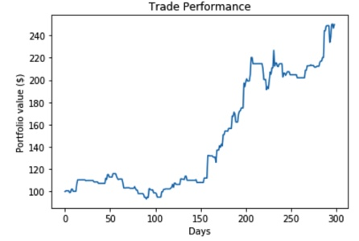
ML Bitcoin Price Prediction Qianhui Dong, Daniel Mao, Rajlakshmi De, Yuming Liu
Problem
Results & Evaluation
In the last decade, bitcoin prices have fluctuated from $0.0008 all the way to $20,000. Whether bitcoin prices will move up or down has been a continuous subject of interest for both large institutional investors as well as personal investors curious about holding BTC in our new age of digital cryptocurrencies.
Our team is building algorithms, using both structured and unstructured data, to predict whether the price of BTC will go up or down in the future.
Model | AUC | TN FP FN TP
CART | 0.57 | 35 8 37 18
Random Forest | 0.51 | 31 12 39 16
SVM | 0.91 | 41 2 7 48
Logistic Regression | 0.95 | 43 0 6 49
Neural Network | 0.62 | 31 12 26 29
Data Understanding
We pull BTC daily open and close price from Yahoo Finance to create both model features and our target. Our target is a binary variable for whether the price of bitcoin is up or down 1 day into the future.
In addition to using bitcoin prices as features, we gathered unstructured news data about Bitcoin by pulling data from the Contextual Web API. news data to conduct sentiment analysis.
Logistic Regression and SVM models provide strong predictive ability to predict tomorrow’s bitcoin price trend based on the previous 30 days of BTC pricing history and the bitcoin sentiment feature.
To further investigate our model performance, we developed a backtesting algorithm that trades BTC using our logistic regression prediction of price trend. Backtesting allowed us to confirm our business case: we can increase porfolio value over time by leveraging our ML model.
Data Preparation
We supplemented bitcoin open and close prices features for each day with the open and close prices for the previous 30 days. We labeled the binary target variable by classifying each day of data based on whether the price of bitcoin went up or down one day into the future.
To leverage the unstructured news data, we used a pre-trained sentiment analyzer from NLTK to label each day’s bitcoin news as positive, neutral, or negative sentiment.
To provide training and testing (holdout) data, we split our dataset based on the time series, such that the first 70% of historical observations were used for training and the last 30% of observations were for the holdout.
Modeling
Conclusion
Deployment
We used five models for our classification problem of identifying whether the price of BTC would be up or down 1 day into the future. We have leveraged SVM, Logistic Regression, CART, Neural Networks, and Random Forest.
To tune our hyperparameters within each of the 5 models, we employed grid search over several hyperparameters using 10 folds. Instead of creating random folds (which would result in look ahead bias), we used forward chaining to create CV folds in which each fold’s holdout data occurred after its training data.
Our modeling effort relied on ROC curves (and their AUCs), confusion matrices, and simple accuracies/errors for prediction performance. We also developed a backtesting algorithm to gauge business impacts.
Logistic regression and SVM machine learning models are effective in predicting bitcoin price trends one day into the future with high AUCs of over 0.9 using just previous BTC price data and bitcoin sentiment analysis. This is further substantiated through positive financial returns in our backtest algorithm. However, not all ML models we attempted were effective.
The results of our work should be deployed as an interface that lets the user know whether tomorrow’s BTC price will be up or down and with what probability. This service should be provided to both financial institutions that trade BTC as well as to personal investors deciding whether to trade BTC.
Notes:
TP

